Slide 1
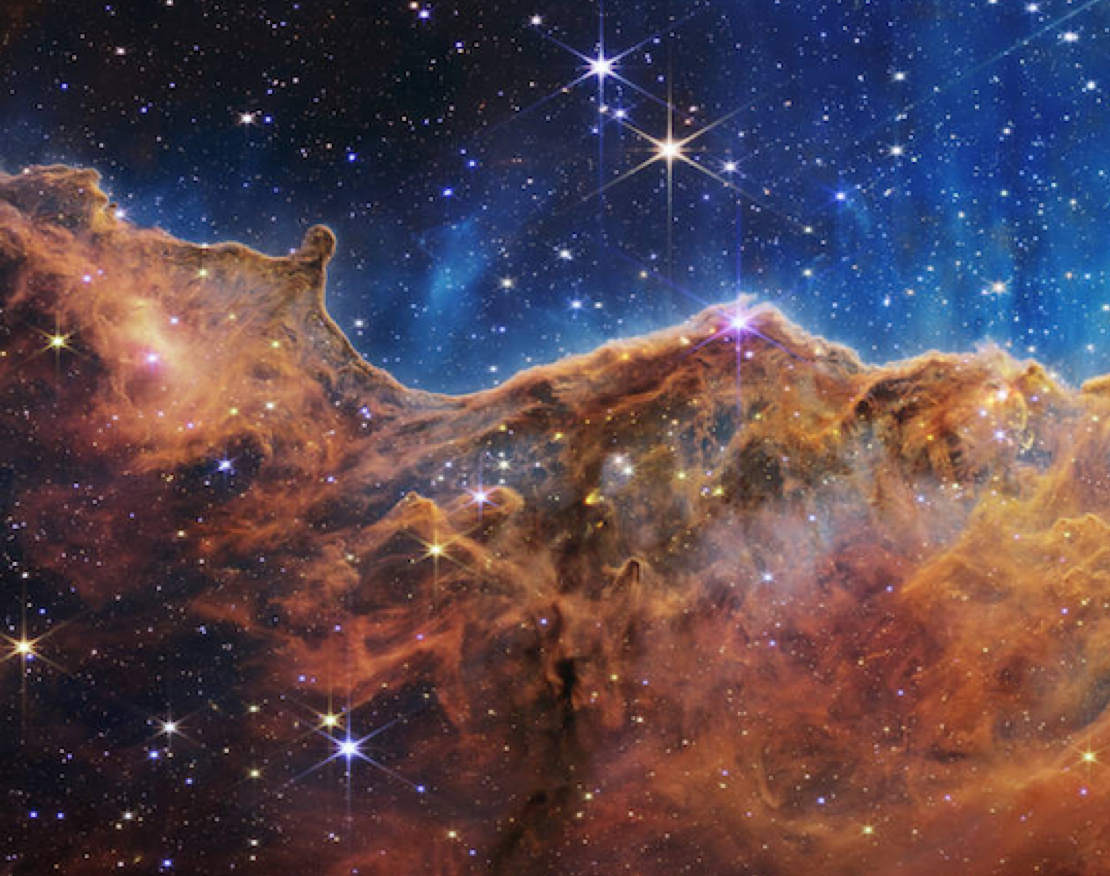
STELLAR PHYSICS
Notes:
Here is a note
With another paragraph.

Slide 2
Slide Title
Hello, world.
Notes:
A speaker note on this slide too.

Slide 3
Section header

Slide 4
Slide Title for Two-Content
Some content on the left.
Some content on the right.

